Slide 1
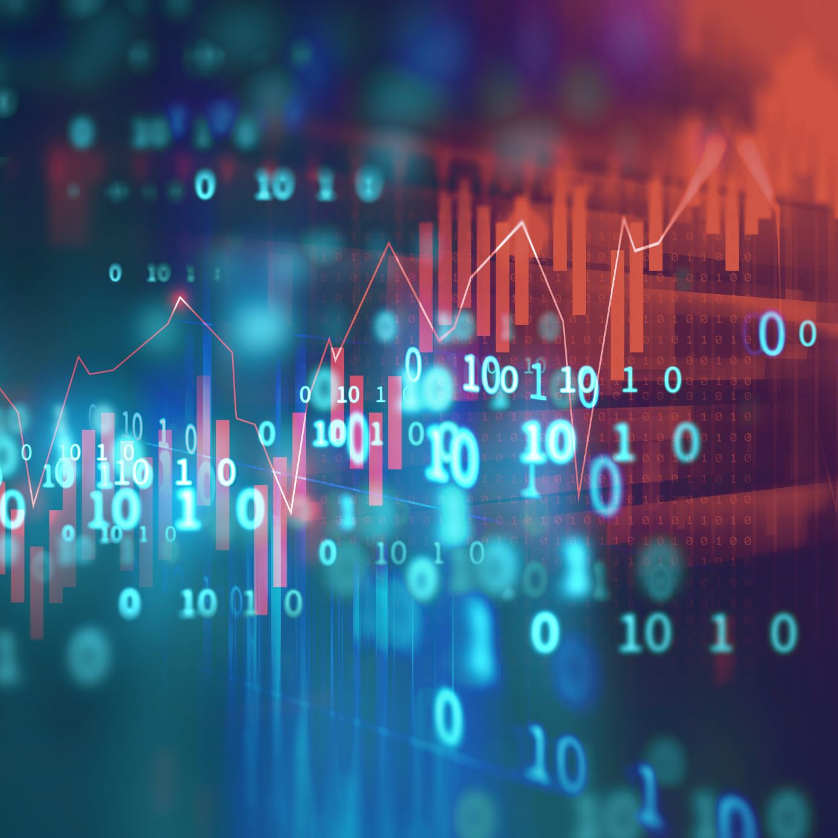
Assignment 1
Sharon Jepkosgei
EPPS 6354

Slide 2
Question One
Examples of applications that use databases include:
Health information system
Medical history
Test results and medications
Library management systems
Availability of a book/article
Author’s information
Online shopping systems – Amazon and eBay
- Price, details, and availability of a product

Slide 3
Question Two
Possible application in domain projects:
Disease monitoring system: Track and control the spread of infectious disease.
Immunization system: Monitor vaccination of people globally.
-Allow easy retrieval of immunization records
-Allow individuals to update their immunization details
Publication archive: Store data relating to publications such as research papers, journals, books, and articles.
- Act a central system for all publications

Slide 4
Question Four
NoSQL were developed to facilitate scalability and support specialized data types
Traditional Databases | NoSQL
Follows the ACID properties (Atomic, consistent, isolated, durable) | Follows CAP/BASE properties (Basically Available, Soft State, Eventually Consistent)
Table-based | Column, graph, and document based
Fixed/predefined schema | Dynamic schema/Schema free
Suitable for financial applications | Suitable for big web applications like social media sites
Notes:
• Atomic: All work in a transaction completes (i.e., is committed to stable storage) or none of it completes.
• Consistent: A transaction transforms the database from one consistent state to another consistent state.
• Isolated: The results of any changes made during a transaction are not visible until the transaction has committed.
• Durable: The results of a committed transaction survive failures
Consistency indicates that all computers see the same data at the same time.
• Availability indicates that every request receives a response about whether it succeeded or failed.
• Partition tolerance indicates that the system continues to operate even if a network failure prevents computers from communicating.
Basically Available (the system seems to work all the time), Soft state (it does not have to be consistent all the time), and Eventually consistent (it becomes consistent at some later time

Slide 5
Question 5
What current databases cannot do:

Slide 6
Question Six
Tables used to store information in social media system
Profile table: Contains user’s information including account name, age, location, preferences, and official name.
Posts table: Contains content shared by a users including images, videos, and photos.
Analytics tables: Records statistics and data of content shared. For example, likes or comments on a post.
Friends table: Contain information of friends’ or followers’ activities like posts shared

Slide 7
The End

